Slide 1
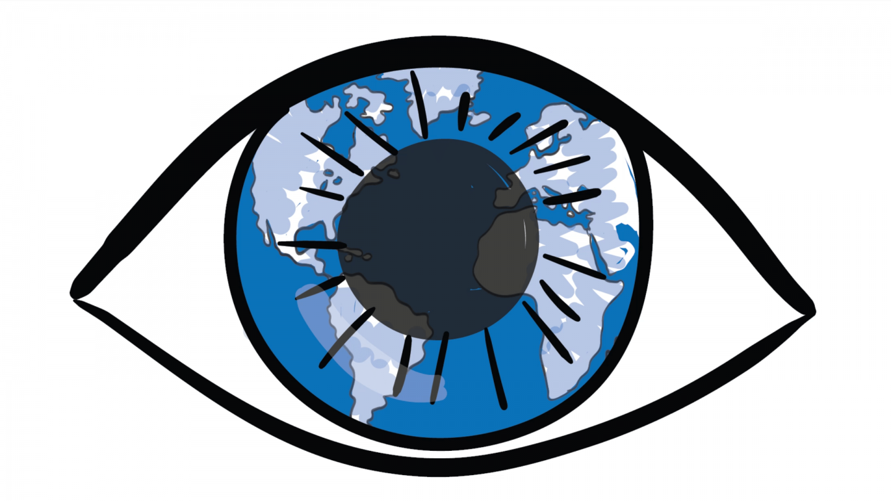
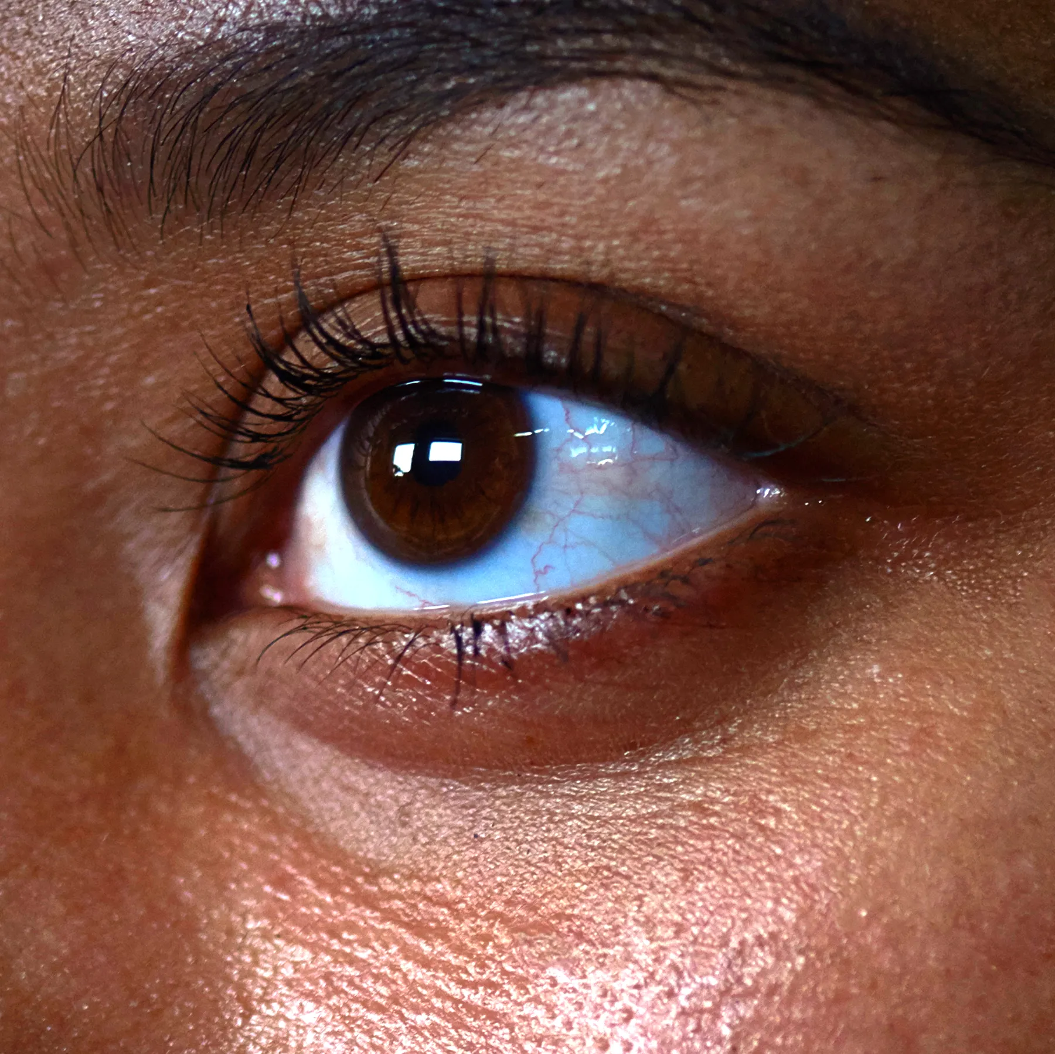
Human Vision
How does it work, limitations and any possible enhancements?

Slide 2
Study Design Dot Points
Model and explain human vision as refraction at a spherical surface with an adjusting lens
distinguish between short-sightedness and long-sightedness, and explain their correction by concave and convex lenses, respectively
investigate the operation of the bionic eye

Slide 3
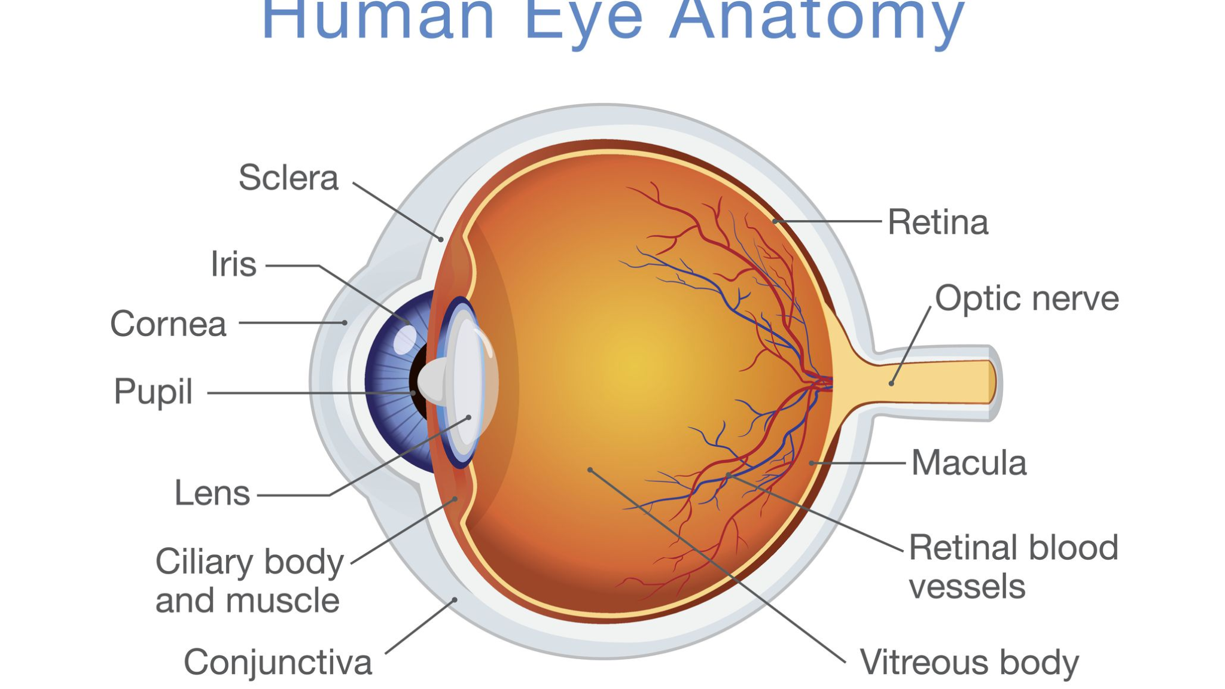
How does Human Vision Work?
In order to see, we must have light, the light rays that pass through a lens and other eye structures is bent/ refracted.
Refraction occurs in the eye when certain eye structures refract the light rays to a particular point of focus at the back of the eye which is essential for sharp vision.
Anatomy of the Eye
https://www.thoughtco.com/how-the-human-eye-works-4155646

Slide 4
How does Human Vision Work?
Light passes through the cornea (clear front layer of the eye). The cornea helps the eye to focus by bending the light rays.
Some of this light enters through the pupil, and the iris controls how much light the pupil lets in.
Light passes through the lens, and works together with the cornea to focus light onto the retina.
When light hits the retina, photoreceptors turn the light into electrical signals.
Electric signals travel from the retina to the optic nerve of the brain. The brain then turns these signals into images you can see.
Notes:
Labelled eye

Slide 5
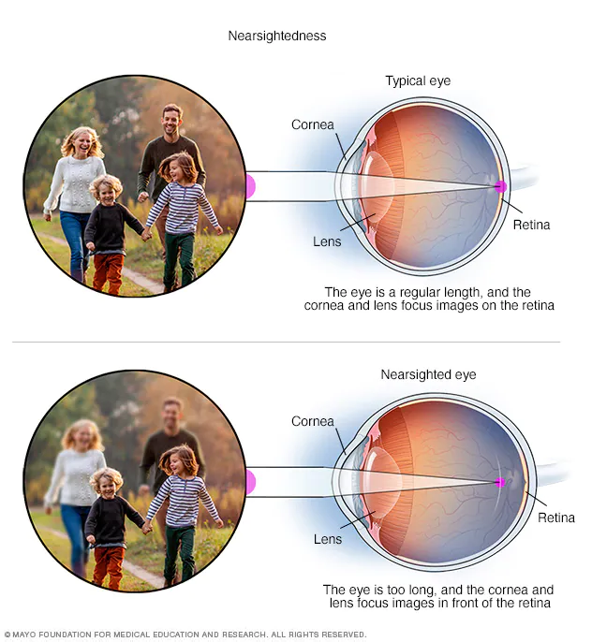
Short- Sightedness (Myopia)
Myopia, causes close objects to seem clear, while distant ones to appear blurry. It happens when light rays incorrectly bend (refract) due to the shape of the eye or specific parts of the eye. The retina is the area on the back of the eye where light should be directed, however it is actually focused in front of the retina, causing Myopia.
A factor contributing to shortsightedness is an eyeball with a cornea or lens that is excessively bent relative to its length, or the eyeball is too long. Myopia can occasionally develop as a result of a mix of these causes.
Myopia often manifests in early childhood, and if one of your parents has the condition, your chances may be increased. Shortsightedness often stabilises in early adulthood, but it can occasionally worsen as people become older.
Near sighted vs normal vision expected focal point https://www.mayoclinic.org/diseases-conditions/nearsightedness/symptoms-causes/syc-20375556#:~:text=Nearsightedness%20(myopia)%20is%20a%20common,to%20bend%20(refract)%20inaccurately.

Slide 6
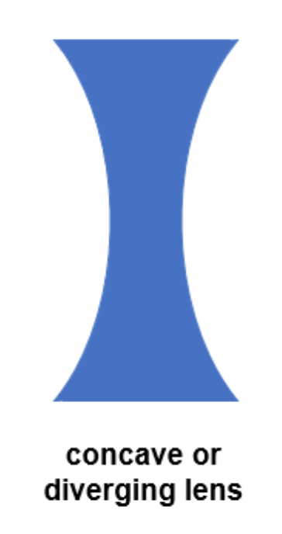
Short- Sightedness (Myopia)- Concave Lenses
Concave lenses: One or both lens surfaces are bent inward. A person with short sightedness, focuses in before the back of the eye (retinal cells). The concave lens spreads the light rays apart so that the rays arrive together in focus at the back of the eye.
Light rays that diverge as they enter the eyes through concave lenses (also known as negative lenses) arrive to a focus a bit further back, directly on the retina. This gives the brain a crystal-clear picture.
In a prism, light is always refracted towards the base. Since the broad base of a concave lens lies near the edges, entering light is diverged, or curved outward towards the borders of the lens. This results in a concave lens, which is a lens that is thicker at the edges and narrower in the centre.
Notes:
How concave rays- photo

Slide 7
Long-Sightedness (Hyperopia/ Hypermetropia)
Affects how you see close objects, but can see objects further away.
Causes: when the eye does not focus the light on the retina properly because:
Eyeball too short
Cornea (transparent layer in front of the eye) is too flat
Lens inside the eye is unable to focus properly.
occurs when light entering the eye concentrates behind the retina rather than on the retina, distorting the image.
In an effort to focus light on the retina, the eye lens will naturally try to adapt by becoming more rounded. Vision blur occurs in hypermetropia patients because they are unable to properly adjust.
The cornea is too flat, causing light rays to bend less, the eyeball is too short, or the lens cannot grow adequately round enough and therefore it lacks power.

Slide 8
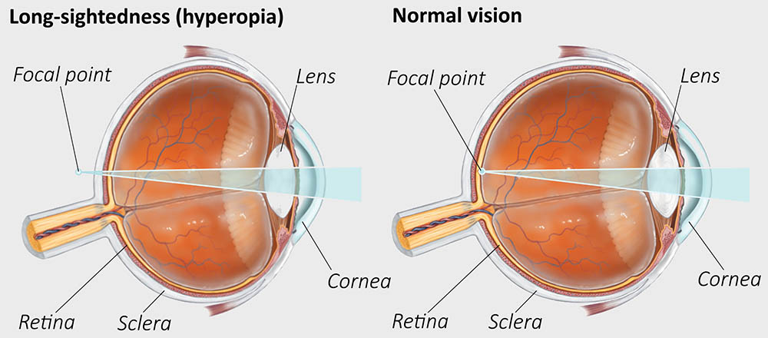
Long-Sightedness (Hyperopia/Hypermetropia)- Convex Lenses
The focal point can be moved by inserting a convex lens to treat hypermetropia before the eye lens, so that the light from a close object focuses on the retina to provide a clear image.
When a lens is convex, one or both of its surfaces curve outward, widening the divergence from the centre.
The convex lens pull the light rays together sooner, since the focus of a long-sighted individual is somewhat behind the back of the eye.

Slide 9
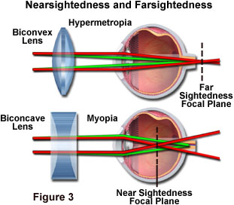
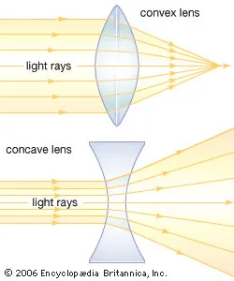
*green- with lenses, red- expected based on limitation
https://micro.magnet.fsu.edu/optics/lightandcolor/vision.html

Slide 10
Bionic Eye
What is the Bionic eye?
It is an artificial eye that enables the brain to receive visual images. Microprocessors, image sensors, radio transmitters, and other networking chips are employed in this procedure.
The Bionic Eye uses a tiny video camera that looks like a pair of glasses and is attached to a computer chip that is carefully positioned just behind the injured eye. The electrical signal that the camera uses to capture the image and communicate it, is one that the brain can readily understand. Although the picture the bionic eye gets is not very transparent, the brain can nevertheless quickly decipher it. The implantation destroys the damaged cells and enters the remainder of the cells.
What does the bionic eye look like?
A camera mounted on a pair of glasses that transmits high-frequency radio signals to a microchip inserted in the retina, making up the bionic vision system.
These signals are converted into electrical impulses by the implanted chip's electrodes, which then activate the retinal cells that form the optic nerve. These impulses are subsequently sent via the optic nerve to the brain's visual processing centres, where they are translated into images.
Notes:
Bionic eye image labelled

Slide 11
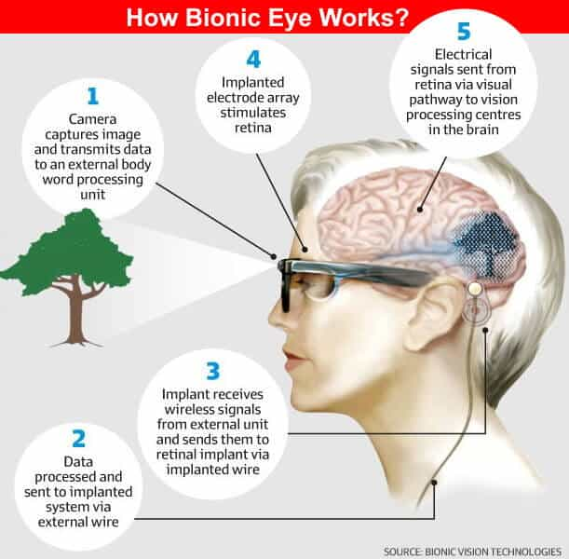
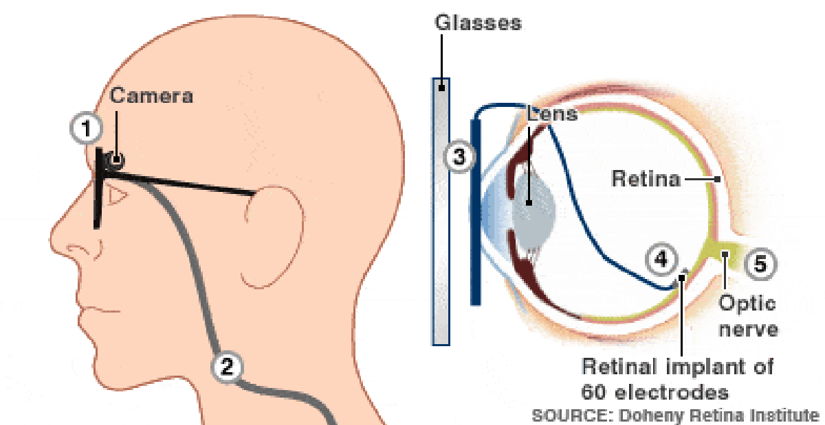
https://www.zmescience.com/medicine/bionic-eye-argus-2-update-04232/
https://www.electricaltechnology.org/2019/11/bionic-eye.html

Slide 12
Bionic Eye
How does it work?
Photoreceptors: specialised neurons that can send signals to the brain, and allow us to see colour and have night vision
There are photoreceptors in the back of the eye that convert light energy into electrical energy that is transmitted to the brain through several layers of retinal nerve cells.
In many types of blindness, like age-related macular degeneration and retinitis pigmentosa, the other nerve cells remain intact despite the death of the photoreceptors. Although the nerve cells themselves are unable to perceive light, they may react to electrical stimulation.
Therefore, since the other nerve cells are still working and can react to electrical stimulation.
Bypassing the visual display, a bionic eye can direct electrical impulses from each camera pixel to an array of stimulating electrodes placed on the eye. This transfers information to the brain, which then receives an electrical signal pattern that resembles what a healthy eye would perceive.
Limitations:
Expensive
Only few eye diseases can be resolved
Artificial processes may lead to more damage or even death
An artificial eye will never replace how normal eyes can see.

Slide 13
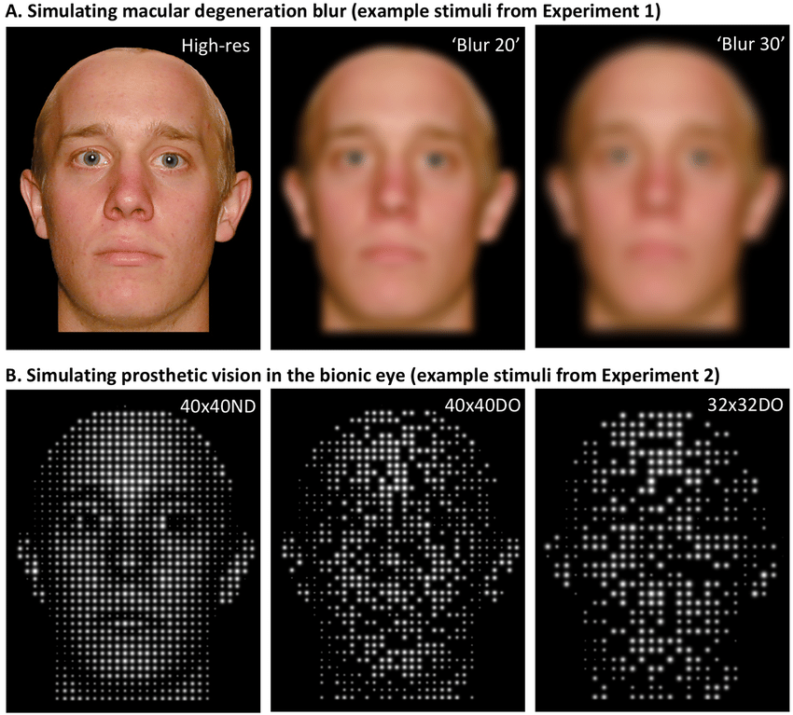
The Bionic Eye

Slide 14
Bibliography
Australian College of Optometry. (2020). Development of a bionic eye. Retrieved from https://www.aco.org.au/development-of-a-bionic-eye/
C4 Sightcare. (2022). Types of Spectacle lenses and their coatings. Retrieved from Types of Spectacle lenses and their coatings: https://www.c4sightcare.com/page30.html
Electrical Technology. (2022). What is a Bionic Eye and How Does it Work? . Retrieved from What is a Bionic Eye and How Does it Work? : https://www.electricaltechnology.org/2019/11/bionic-eye.html
Graduate School of Biomedical Engineering, UNSW. (2022). Bionic eye implant. Retrieved from https://www.unsw.edu.au/engineering/our-schools/biomedical-engineering/our-research/research-areas/bionics/bionic-eye-implant
Health Direct. (2021). Long-sightedness (hyperopia). Retrieved from https://www.healthdirect.gov.au/long-sightedness-hyperopia

Slide 15
Bibliography
Heiting, G. (2022). Eye refraction and function: How does the eye work? Retrieved from https://www.allaboutvision.com/en-au/eye-exam/refraction/
Mayo Clinic. (2022). Nearsightedness. Retrieved from Nearsightedness: https://www.mayoclinic.org/diseases-conditions/nearsightedness/symptoms-causes/syc-20375556#:~:text=Nearsightedness%20(myopia)%20is%20a%20common,to%20bend%20(refract)%20inaccurately
National Eye Institute. (2022). How the Eyes Work. Retrieved from https://www.nei.nih.gov/learn-about-eye-health/healthy-vision/how-eyes-work#:~:text=When%20light%20hits%20the%20retina,into%20the%20images%20you%20see
NHS. (2022). Overview -Long-sightedness . Retrieved from Overview -Long-sightedness : https://www.nhs.uk/conditions/long-sightedness/#:~:text=Causes%20of%20long%2Dsightedness&text=the%20eyeball%20is%20too%20short,is%20unable%20to%20focus%20properly
Sonia Kelley, O. M. (2022). How does a concave lens correct nearsightedness? Retrieved from https://www.allaboutvision.com/conditions/refractive-errors/how-lenses-correct-myopia/

