Slide 1
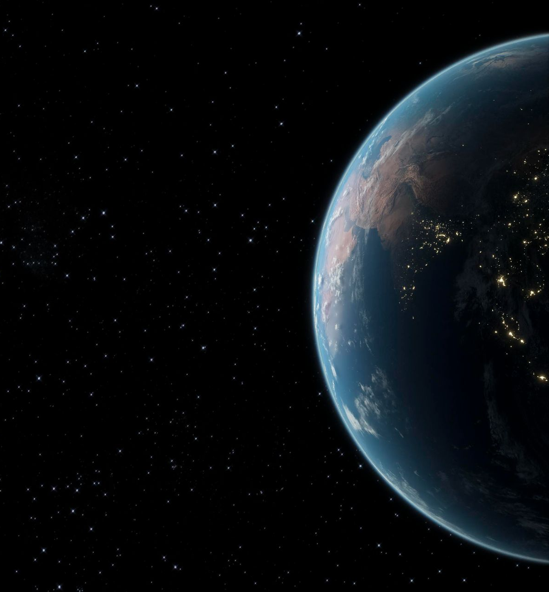
Is There Life Beyond Earth’s Solar System?
Angelique Vargheese

Slide 2
Key Knowledge
01
02
Apply the Drake equation: N = R* fpneflfifc L, as a way of predicting the likelihood of life existing in the Universe by making reasonable assumptions based on evidence and speculation
Explain the use of the Fermi paradox to question the possibility of life outside Earth’s Solar System and identify its counter arguments

Slide 3
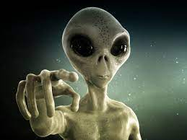
Conditions For Life Beyond Earth
Main requirement for life is:
Water
Bioessential Elements
Many scientists believe that life can be found on Jupiter’s moon, Europa, and Saturn’s moon, Enceladus, because of the presence of liquid water (underneath the frozen surface)

Slide 4
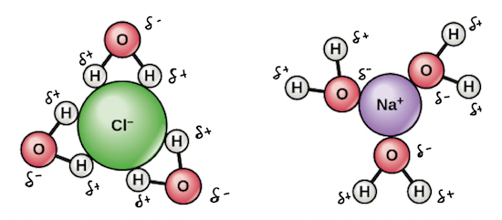
Water:
Main requirement is water:
Water acts a solvent which allows key chemical reactions to occur. Water is a good solvent as a result of its polarity.
Water assists with heat conduction and let light in
Critical to cellular function
Fluid that lubricates the working of the cell
Waters abundance is why life depends on it
Serves as a transform medium for nutrients

Slide 5
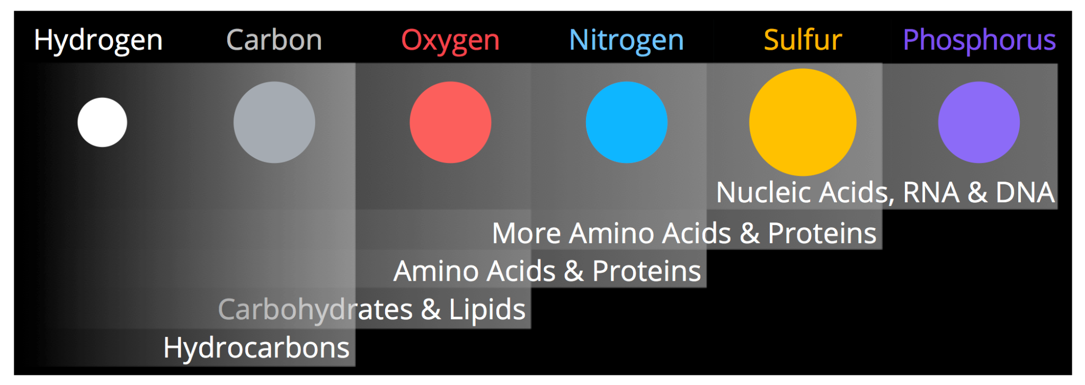
Bioessential Elements:
Bio essential elements:
Nitrogen and phosphorus are key components of DNA and RNA
Nitrogen is important for protein creation, amino acids and for many other processes such as photosynthesis and making chlorophyll
Carbon is extremely important for life it helps to form compounds and is apart of all living things
If the lifeforms were in any way similar to life on Earth they’d require similar elements for their chemical makeup
Hydrogen is essential for life because it is responsible for the helium in our world and because once 2 hydrogen atoms combine with an oxygen atom, it produces water
Carbon, hydrogen, nitrogen, oxygen, sulfur and phosphorus make up 98% of living matter on Earth, so these elements would likely be necessary for extra terrestrial life

Slide 6
The Drake Equation
N = R* fp x ne x fl x fi x fc x L
R* = mean rate of star formation
L= length of time that civilisations can communicate
ne = mean number of planets (per solar system) with an environment suitable for life
fi = fraction of intelligent life
N= number of civilisations in the Milky Way galaxy that we can communicate with
fl = fraction of life support
fc = fraction of intelligent life that develops communicative technology
fp = fraction of stars that have planets
Notes:
https://www.science.org.au/curious/space-time/life-beyond-earth

Slide 7
The Drake Equation

Slide 8
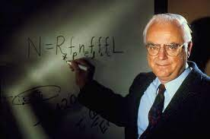
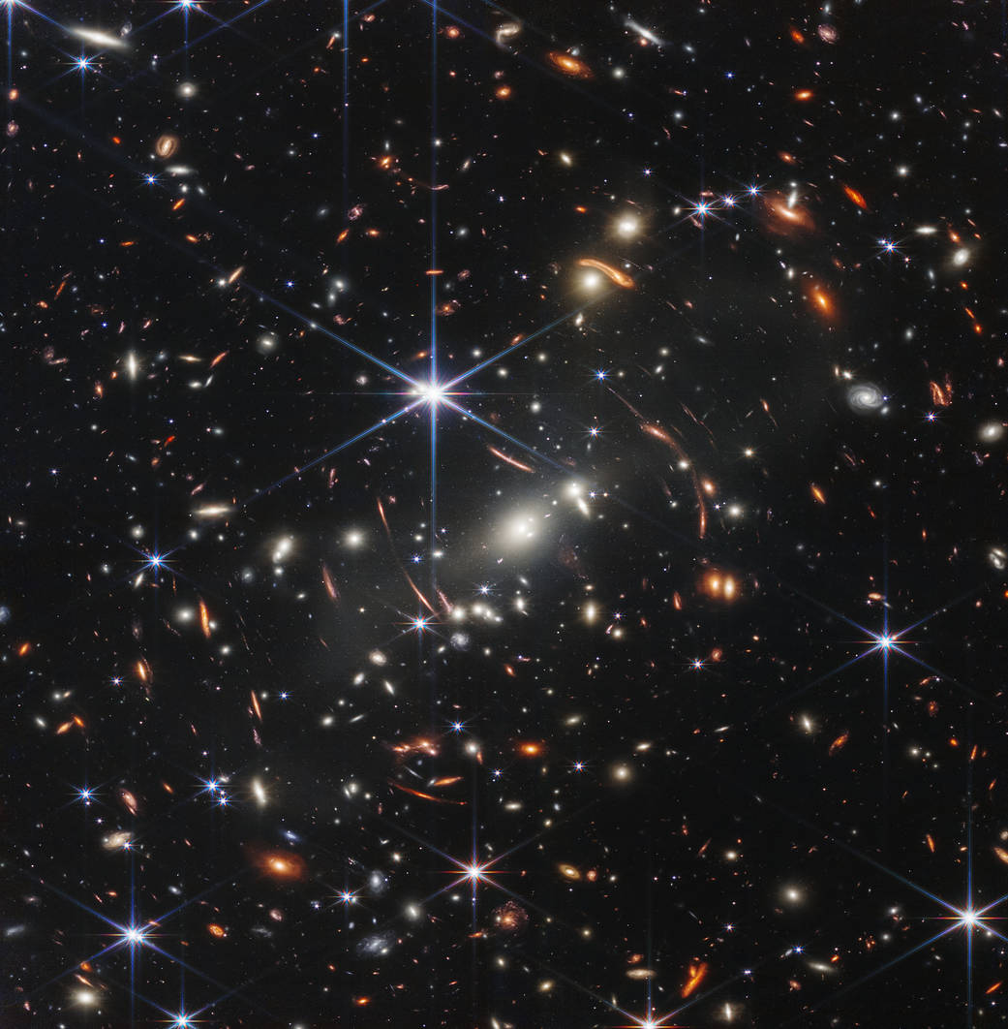
The Drake Equation
Proposed by astrophysicist Frank Drake in 1961, while at a meeting with the Search for Extra Terrestrial Intelligence (SETI) community
Used to estimate the odds of communicating civilisations in our galaxy
Challenge with this is that none of the variables have firm numbers
However, as recent discoveries grow, this equation will become even more useful
Research on exoplanets specifically assist with the discovery of communicating and intelligent civilisations
The original variables hypothesised by Drake were R*=1/yr fp=0.2 - 0.5 ne =1-5 fl=1 fi = 1 fc=0.1-0.2 L= 1000- 100,000,000
If the lower values are used then the number of intelligent civilisations in our Milky Way is 20, but if the higher values are used then that number increases to 50,ooo,oo0
There are vaguely known, updated values for these variables:
R*=3 /yr fp=0.5 ne =2 fl=1 fi fc=0.01
(as stated on Britannica.com with slight variations to R*)
Although we have no established value for L, we can insert the rest of the variables to find an approximate for the Drake Equation:
N= L x 0.03

Slide 9
A Deeper Look Into These Variables
Mean Rate of Star Formation:
The mean rate of star formation is estimated to be 0.5-5.93 solar masses per year (M⊙ yr−1) , with most calculations predicting 3 solar masses are created per year (this is expected for our galaxy at least)
This variable is important for calculating the number of civilisations in our Milky Way since we can use the fraction of stars that have planets to predict the amount of planets that will be created with the rate of star formation
Fraction of stars that have planets:
Around 17% of stars have a planet that nears the size of Earth
It is estimated that since there are over 100 billion stars in the Milky Way then there has to be near 17 billion planets the size of our Earth
These planets contribute to our search for Earth 2.0 since the size of the planets assists with making it potentially habitable

Slide 10
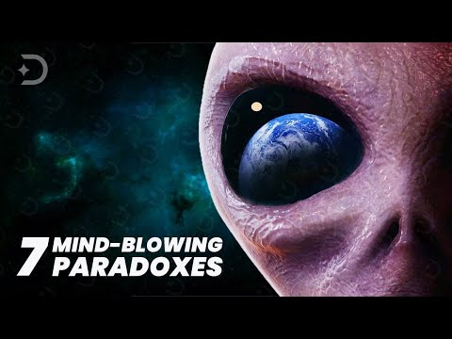
The Fermi Paradox

Slide 11
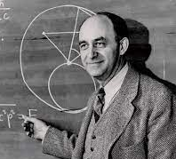
The Fermi Paradox
Italian Nuclear physicist Enrico Fermi proposed this paradox
Simply put “Where is everybody?” (Fermi questioned this after lunch at Los Alamos Laboratory after a discussion on UFOs)
He estimated that there were a large number of stars in the galaxy (around 3 billion with many of them much older than the sun) and that there was high percentage that many of these stars hosted planets that are suitable for life to grow on
In this percentage of habitable planets, there also a likelihood that
Because of the constant expansion of space, our space exploration technology (as much as its advancing) would still take millions of years to colonise, so Fermi posed that if there were civilisations on these significantly older planets, wouldn’t they have colonised or visited these other planets?

Slide 12
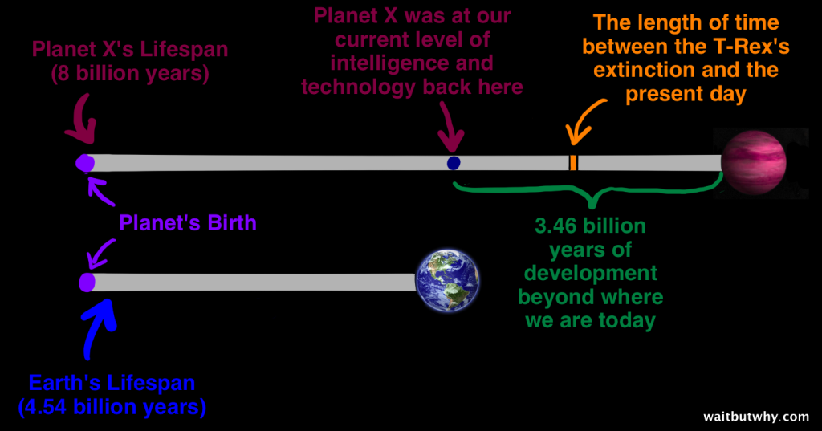
The Fermi Paradox
https://waitbutwhy.com/2014/05/fermi-paradox.html

Slide 13
Counter Arguments Against the Fermi Paradox
They are too far away to contact:
Light Years are a unit of measurement that many people cannot grasp, and our galaxy nears over 150,000 light years. Ultimately, to communicate over this distance would prove to be difficult more any intelligent civilisation, including us. Similarly, receiving those signals from other civilisations is just as difficult.
2) We may be the first civilisation in this galaxy
Although this is a hard concept to understand, if we are the first civilisation then it may be millions of years before the next civilisation is born and even more years before that civilisation can communicate. By that time we will our civilisation may have even died off, so we would never have witnessed the creation of another civilisation. If this was to happen, then this process would likely repeat itself, making it near impossible for a civilisation to communicate with another civilisation if the life cycle of each civilisation alternates.

Slide 14
Counter Arguments Against the Fermi Paradox
3) The Zoo Hypothesis
This hypothesis states that if there are civilisations out there, then they are deliberately ignoring us and our communications. This was hypothesised by John A. Ball in 1973 when addressing the Fermi Paradox and other assumptions made by SETI.
“I believe that the only way that we can understand the apparent non-interaction between “them” and us is to hypothesize that they are deliberately avoiding interaction and that they have set aside the area in which we live as a zoo.
“The zoo hypothesis predicts that we shall never find them because they do not want to be found and they have the technological ability to ensure this. Thus this hypothesis is falsifiable, but not, in principle, confirmable by future observations.”

Slide 15
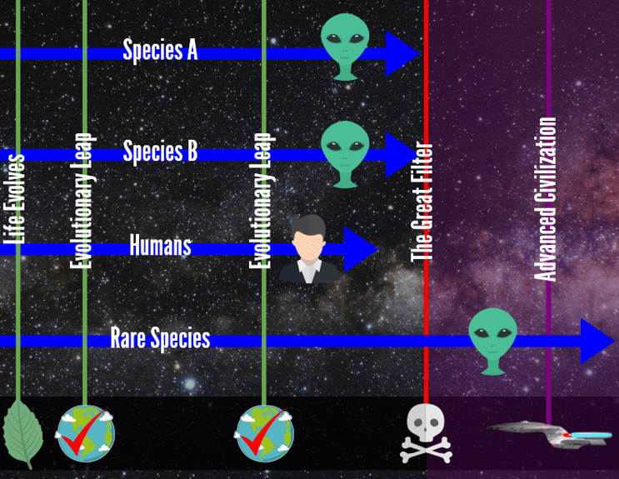
Counter Arguments Against the Fermi Paradox
4) The Great Filter
The Great Filter was proposed by Robin Hanson and he suggested that “The Great Filter can be thought of as a probability barrier. It consists of [one or] more highly improbable evolutionary transitions or steps whose occurrence is required in order for an Earth?like planet to produce an intelligent civilization of a type that would be visible to us with our current observation technology.” Essentially, the Great Filter states that there is an extremely difficult obstacle that civilisations must overcome. To today, physicists are still unsure whether we have already overcome this obstacle or if we are leading up to it. One of the main guesses for the Great Filter (if it is ahead of us) is climate change or a consequence of
of our technology (e.g: extremely advanced artificial intelligence or a
Doomsday device)
:

Slide 16
Thank you :)

